Slide 1


NODE.JS GLOBAL
Middleware. Frameworks
FEBRUARY, 2019

Slide 2
AGENDA
What is Express
What is middleware
Build in modules
App structure

Slide 3
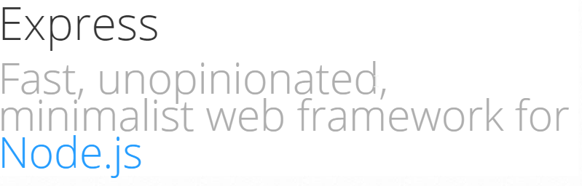
WHAT IS EXPRESS
$ npm install express

Slide 4
REQUEST RESPONSE CYCLE
Request
Configuration
Application middlewares
Route middlewares
View (html / json)
Response

Slide 5
MIDDLEWARE IS THE BACKBONE
Express = Routing + Middlewares

Slide 6
MIDDLEWARE CONCEPT
Execute any code.
Make changes to the request and the response objects.
End the request-response cycle.
Call the next middleware in the stack.

Slide 7
MIDDLEWARE TYPES
Application-level
Router-level
Error-handling
Built-in
3rd party (ex.: xxx-parser)

Slide 8



APPLICATION LEVEL MIDDLEWARE
Change anything to the request and the response objects and then call next() .
You can attach middleware to the specific route
Do not forget about next(). This code will never return control to the route handler

Slide 9

ERROR-HANDLING MIDDLEWARE
Has four arguments – and the first is error .
You can call it by next(err) in any middleware
Once next(err) is called, all other non-error middlewares would be skipped

Slide 10
BACK TO EXPRESS
express()
Application
Request
Response
Router

Slide 11
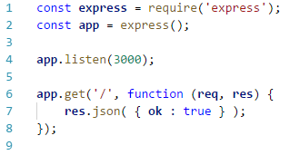
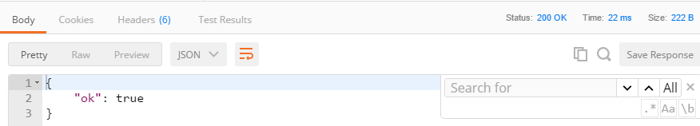
SIMPLE EXPRESS APP

Slide 12
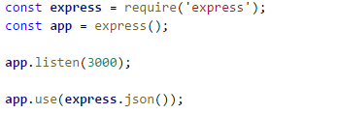
express()
Creates an Express application
Provide some useful middlewares - static to server static files - json – to parse JSON to body - urlencode – to parse urlencoded body

Slide 13
APPLICATION
Routing HTTP requests (all, METHOD)
General app configuration (enable / disable)
Adding middleware (use)
Global parameters handling
Registering and using a template engine(engine, render)

Slide 14
APPLICATION: ROUTES
all
METHOD
use (for middleware)

Slide 15
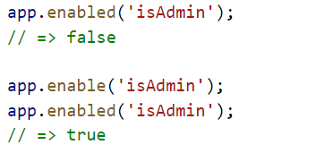

APPLICATION: PROPERTIES
listen
locals
set & get
disable & enable

Slide 16
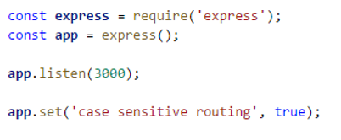
APPLICATION: SETTINGS
case sensitive routing
strict routing
x-powered-by
trust proxy

Slide 17
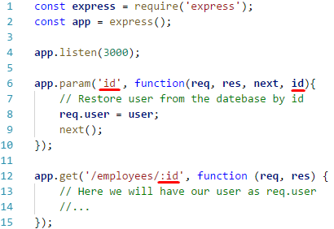
APPLICATION: PARAM
Adds callback triggers to route specific route-parameters
.. also can be used to load user settings

Slide 18
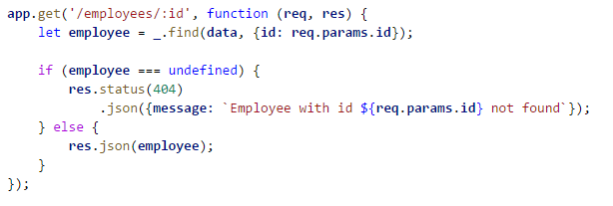
REQUEST
Extended version of IncomingMessage from http module
body
cookies
params (path params)
query (query params)

Slide 19
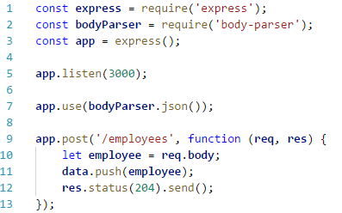
REQUEST: BODY
Contains submitted data as key-value pairs and undefined by default
Use body-parser to populate body from json

Slide 20
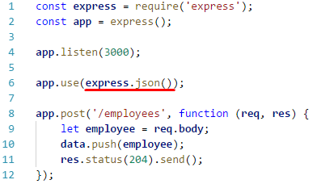
REQUEST: BODY (4.16.0+)
Contains submitted data as key-value pairs and undefined by default
Use body-parser to populate body from json
Use express.json middleware to populate body from json

Slide 21
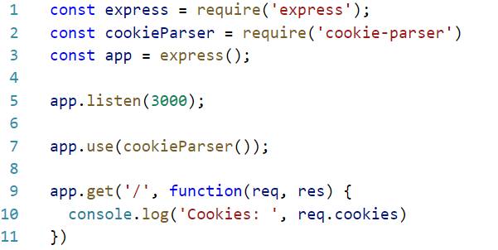
REQUEST: COOKIES
Contains cookies as key-value pairs
Use cookie-parser to populate

Slide 22

REQUEST: PARAMS
Object with properties mapped from named route “parameters”
.. or array of elements captured by regular expressions
Route path: '/employees/:id'
Request url: http://localhost:3000/employees/42
req.params: {"id": "42"}
Route path: '/employees/*'
Request url: http://localhost:3000/employees/42
req.params[0]: "42”
Route path: '/employees/*'
Request url: http://localhost:3000/employees/42/awards/17
req.params[0]: "42/awards/17"

Slide 23
REQUEST: QUERY
Object with properties mapped from query string parameters
If there is no query string, it is the empty object, {}.
You have to merge req.params and req.query in order to get all incoming parameters – from recourse path and query string
Request url: http://localhost:3000/employees?order=desc
req.query: {"order": ”desc"}

Slide 24
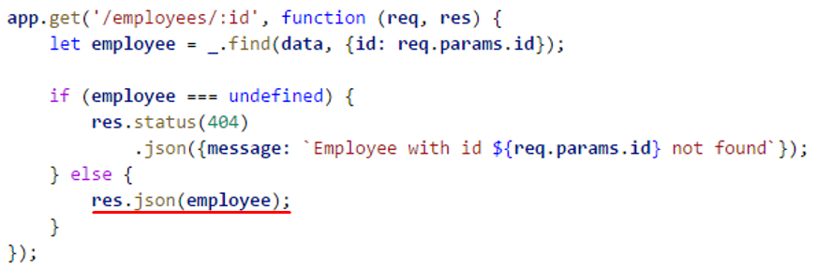
RESPONSE
Represents the HTTP response that an Express app sends for HTTP request
locals
Sending response

Slide 25
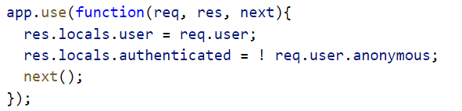
RESPONSE : LOCALS
Contains response local variables scoped to the request
Available only to current request / response cycle (unlike app.locals)
.. useful for storing authenticated user, user settings, etc.

Slide 26
SENDING RESPONSE
end – quickly end the response without any data
sendStatus – ответ только со статусом и его описанием
send – default response with data (Buffer, String, object, or Array)
sendFile – sends the file at the given path to the client
json –JSON response with proper content-type
jsonp – JSON response with JSONP support. Callback called callback by default
redirect – redirects to the specified URL (or path). You can set status code
render – renders a view and sends the rendered HTML string to the client

Slide 27
ROUTER
The object with isolated instance of middleware and routes
METHOD
all
param
route
use

Slide 28
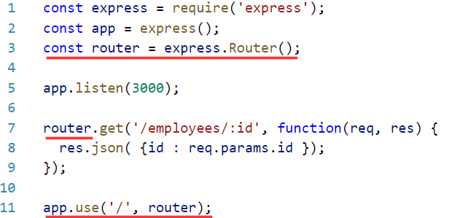
ROUTER: EXAMPLE

Slide 29

ROUTER: OPTIONS
caseSensitive: when disabled treat /Users as /users
strict – when disabled treat /Users as /Users/
mergeParams - Preserve the req.params values from the parent router
All options are disabled by default

Slide 30
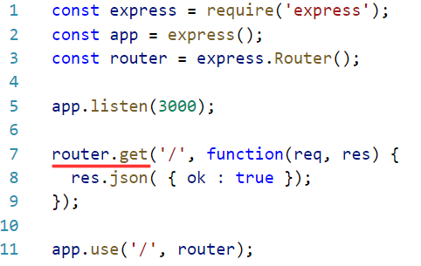
ROUTER: METHOD
Provide the routing functionality for specific HTTP methods (verbs)

Slide 31

ROUTER: ALL
Provide the routing functionality for all HTTP methods
.. useful for checking user authentication and load user settings

Slide 32
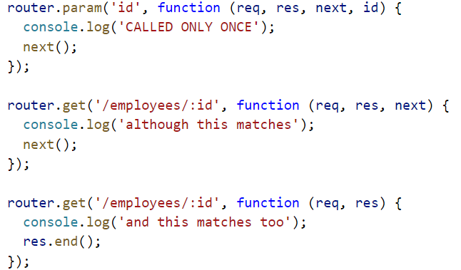
ROUTER: PARAM
Adds callback triggers to route specific route-parameters
.. also can be used to load user settings

Slide 33
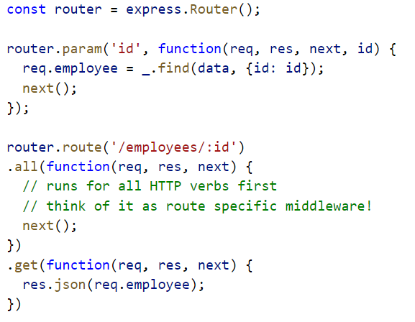
ROUTER: ROUTE
Returns an instance of a single route
Useful for avoiding duplicate route naming and thus typing errors

Slide 34
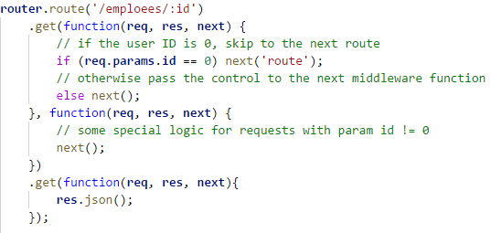
ROUTER: ROUTE NEXT
You can provide multiple callback functions that behave just like middleware
Call next('route') to bypass the remaining route callbacks

Slide 35
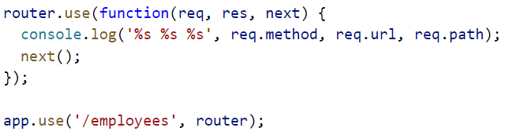
ROUTER: USE
Adds the specified middleware function
.. and optional mount it to the specific path

Slide 36
MIDDLEWARE CONCEPT. ONE MORE TIME
Execute any code.
Make changes to the request and the response objects.
End the request-response cycle.
Call the next middleware in the stack.

Slide 37
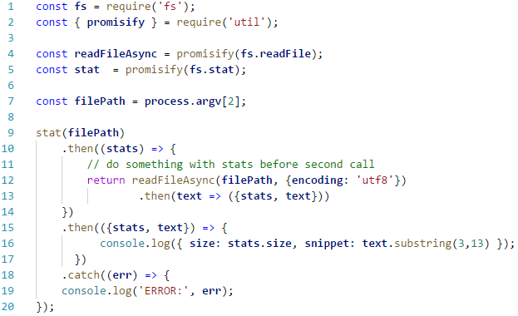
OLD-FASHIONED CALLBACKS

Slide 38
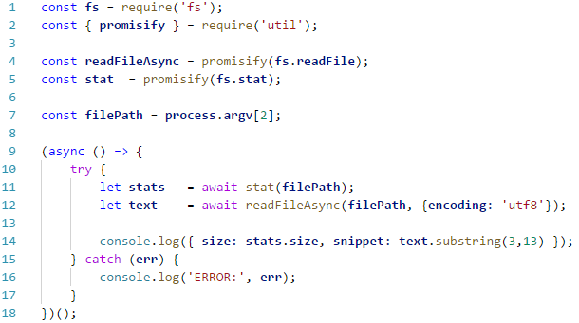
AND NOW.. ASYNC!

Slide 39
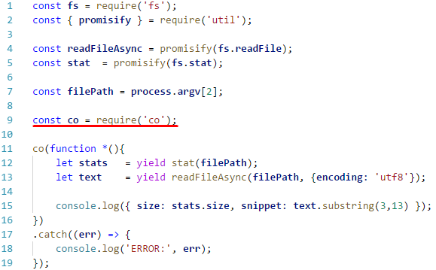
MODERN CONTROL-FLOW WITH CO

Slide 40
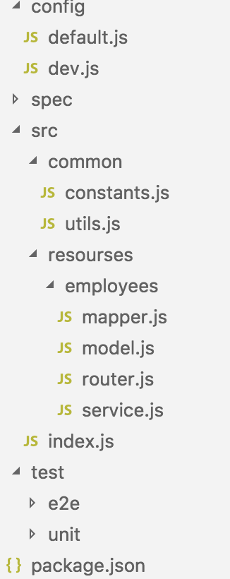
APPLICATION STRUCTURE (ONE OF)
In config - files by environment with default one
spec with your API documentation (swagger)
In src – common stuff and resources
Every resource has it’s own router with service, possibly mapper and/or model

Slide 41
EXTRA MODULES
Config handler – get config for the current environment and validate it - config, nconf, dotenv
Error handler – throw error with extra details, handlers for popular errors - boom, http-errors
Log handler – log errors and debug data for different environments - winston, banyan
Validator – validate request payloads and params - ajv, joi
Helpers – add HAL links, check permissions, test request/response against spec - halson, ..

Slide 42
USEFUL LINKS
ExpressJS API documentation
Writing middleware for use in Express apps
Express middleware
Error handling
API Design in Node.js Using Express and Mongo (lynda.com)
Getting Started with Express.js (egghead.io)
Designing a Beautiful REST+JSON API

Slide 43
NODE.JS GLOBAL
Middleware. Frameworks BY Vladislav Lomako
Mohamadali ganji

